Slide 1
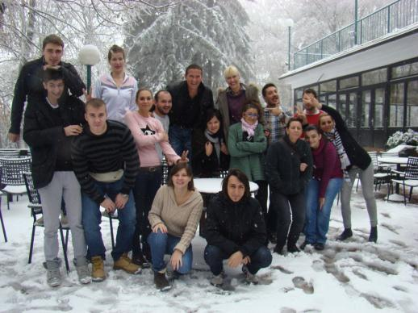
CROATIA 2012
PROGRESS
ALEN: Mreža za ulazak u život odraslih: “Osnaživanje i aktivacija mladih
u nepovoljnim situacijama”
EUROPSKA KOMISIJA,
OPĆA UPRAVA ZA ZAPOŠLJAVANJE,
SOCIJALNA PITANJA I UKLJUČIVANJE
REPUBLIKA HRVATSKA,
MINISTARSTVO SOCIJALNE POLITIKE I MLADIH

Slide 2
WHO IS WHO?
ALEN
Peer assistants
Mentor
Peer assistants
Mentor
Young person
Young person

Slide 3
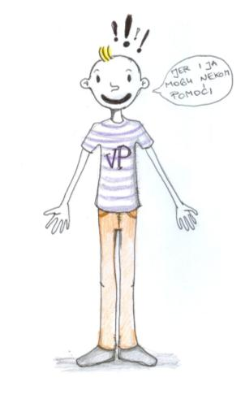
Peer assistants
WHO IS WHO?
Peer assistant supports a peer on a path to independent life by establishing friendly and supportive relationship.
Peer assistant is a young person that came out of public care system . He/she is responsible and independent and in that way acts as a role model and eases they way towards independence.
10 young persons, age 20 -25

Slide 4
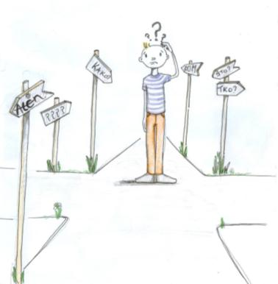
Young person
WHO IS WHO?
10 young persons
Recently left social care institutions
Live in Osijek or Zagreb area
Age 17 – 20
Participating agreement (weekly meetings, punctuality, breaching agreement, conflicts)

Slide 5
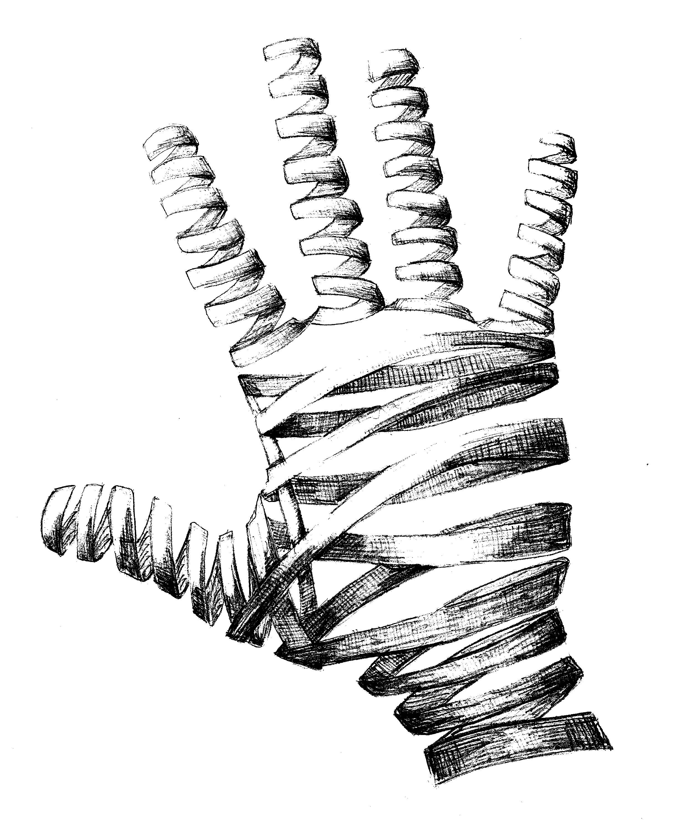
Mentor
WHO IS WHO?
Professional
Goal:
Resolving possible difficulties and doubts
Expanding perspective
Providing support
Strengthen
self-consciousness, responsibilities and competences
Maintaining inner motivation

Slide 6
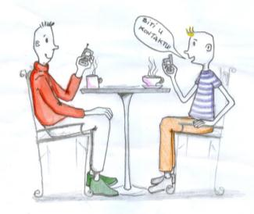
WHAT DID WE DO?
Selection
Training
Peer support
Mentoring
Closing process and evaluation

Slide 7
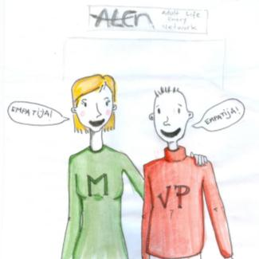
WHAT DID WE DO?
Conference (opening /closing)
Regional meeting (beginning/end)
Evaluation
Partners meeting
Promotion & recommendations

Slide 8
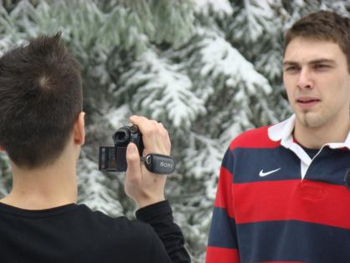
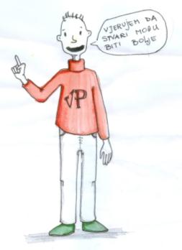
Creative…
WHAT DID WE DO?
Call for youth
Booklet for future peer assistants
http://www.youtube.com/watch?v=Tem6DXIxYFI&feature=youtu.be

Slide 9
THE RESULTS?

Slide 10
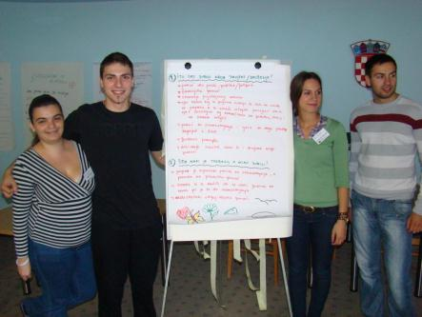
Young person
Employment:
Education
Rights
New knowledge and skills (communication, problem solving, cooperation, planning and decision making , health, money management, …)

Slide 11
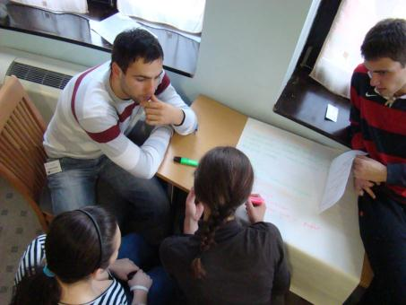
Young person
Experience of success/positive change in resolving existential problems that leads to self-confidence and a positive look at life
Expanding social network
Informed on cultural sport and other events and support systems in society

Slide 12
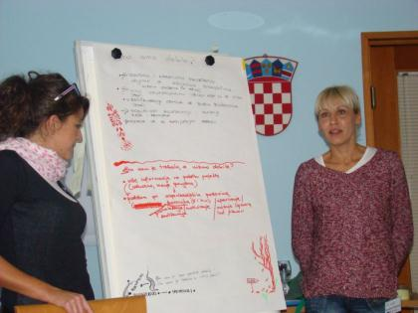
Young person
Have plans for continuation of education
Are more aware of own responsibility, personal boundaries,
Are more trusting and are more tolerant towards differences
Lower feeling o stigmatization and are better coping with it

Slide 13
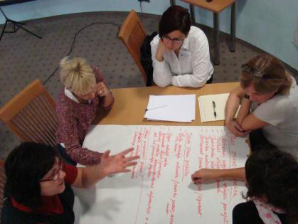
Young person
More directed towards proactive behaviors
More aware of the possibilities for influencing the social and political life
Readiness to provide support to others

Slide 14
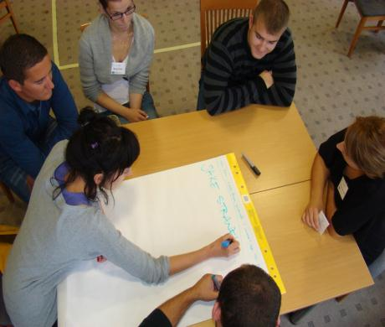
Peer assistants
Improved self-respect and a sense of personal worth and successfulness
Readiness for social/political activism
Improved communicational skills and cooperation
More realistic in viewing own responsibility and personal bounders
Broaden social net
Highly motivated to continue to be peer assistants

Slide 15
FOR THE FUTURE
Continuation of this project
Establishing a CRO network of peer assistants
Peer-assistants and beneficiaries should promote the service in institutions (youth and professionals)
During peer-assistant and mentors training have more mutual workshops
Have a workshops of peer-assistants and potential beneficiaries before pairing up
Have more mutual meetings during a year
Financial support: telephone, travel, coffee…
Better media coverage
Symbolic honoraria for peer-assistants

Slide 16
Get involved!

