Slide 1
SECOND SESSION: EVIDENCE-BASED POLICY MAKING IN EDUCATION
Aleksandar Baucal
University of Belgrade

Slide 2
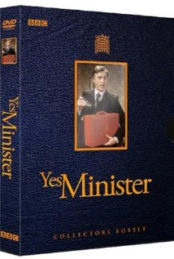
Some reminders: funny side of the EBPM
Otto von Bismarck: “Laws are like sausages: it’s better not to see them being made”
Or TV Series “Yes Minister”

Slide 3
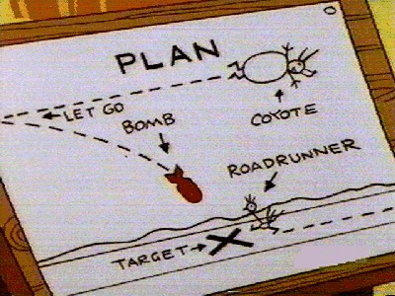
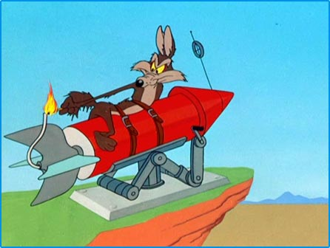
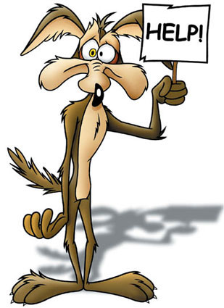
I cannot help myself…
…not to mention Road Runner cartoon and his wishful based policy making

Slide 4
Long history, but…
Some authors have suggested that EBPM had been invented in 14th century in order to discipline the rule of despots (Banks, 2009)
Florence Nightingale in 1920s addressed English Parliament with the following words
You change your laws and your administering of them so fast, and without inquiry after results past or present, that it is all experiment, seesaw…
Tony Blair spoke of ending ideologically-based decision making and ‘questioning inherited ways of doing things’

Slide 5
…but we are still struggling to make it more frequently
In our region the policy making is still more based on:
Feeling (I like it)
Intuition (Somehow I know it will work)
Power (Because I told so)
Ideological wishful thinking (I wish to create better world)
Particular interests (They told me so)
….
Better for us not to know what else can be put on the list

Slide 6
However, pressure has is becoming stronger…
More actors is involved formally in the policy makers (for example, national education councils)
Public is more willing to question policy decisions, but you never know when it is going to happen
Context of the economic crises
Context of globalization and need to improve competitiveness
The EBPM has become a buzz word

Slide 7
Key goal: Better evidences in each step of the policy cycle
Problem identification
Evaluacija
Analysis of policy options
Implementation and monitoring
Policy decision
Implementation planning

Slide 8
The EBPM needs different kind of evidences?
Evidences “describing” current state of affairs and its distance from benchmarks (set of relevant indicators)
Evidences on how certain shortcoming (gap) in education is fabricated
Evidences on impact of different interventions and policies and its cost/benefit ration
Evidences on stakeholder understandings and attitudes

Slide 9
Some specific goals
To widen scope of those who is supposed to be counted as an evidence provider
For example, to involve more practitioners into the policy making?
To make evidences more diverse
Case studies, qualitative studies…
To make evidences more policy friendly in terms of the format and the content
To “pull” policy makers to guide themselves more by evidences?

Slide 10
Three examples
A relatively good example
Introduction of obligatory preschool preparatory program in Serbia
Not so good example
Free textbook policy
“Missing opportunity” example
Finding from secondary PISA analysis that very poor, but very competent student are overrepresented in the shorter VET SE
There is budget for scholarships, but it is not designed in a way to support these students
Missing opportunity for win-win policy

Slide 11
Issues for dicussion
If the EBPM idea is an obvious and compelling idea why it is still not a dominant practice?
What should be done in order to include practitioners into the production of evidences?
What researchers and policy makers should change in their mind, heart, and dominant practice in order to make the EBPM as a dominant practice?
Describe a good case that could serve as a role model for key actors of the EBPM.
Describe a missing opportunity case (where there was opportunity for EBPM, but it was missed) that could serve as a reminding tool for key actors of the EBPM

