Slide 1
Research and Knowledge Mobilisation in Education
Tracey Burns
7 December 2012
Belgrade

Slide 2
Background
Educational R&D: Trends, Issues and Developments (1995)
2002-6: national reviews of educational R&D:
NZ, England, Mexico, Denmark, Switzerland
Evidence in Education: Linking Research and Policy (2007)

Slide 3
General points
Low levels of investment in educational R&D
Weak research-policy links
Low system capacity
Methodology
Knowledge networks and brokerage
Scaling up and sustainability

Slide 4
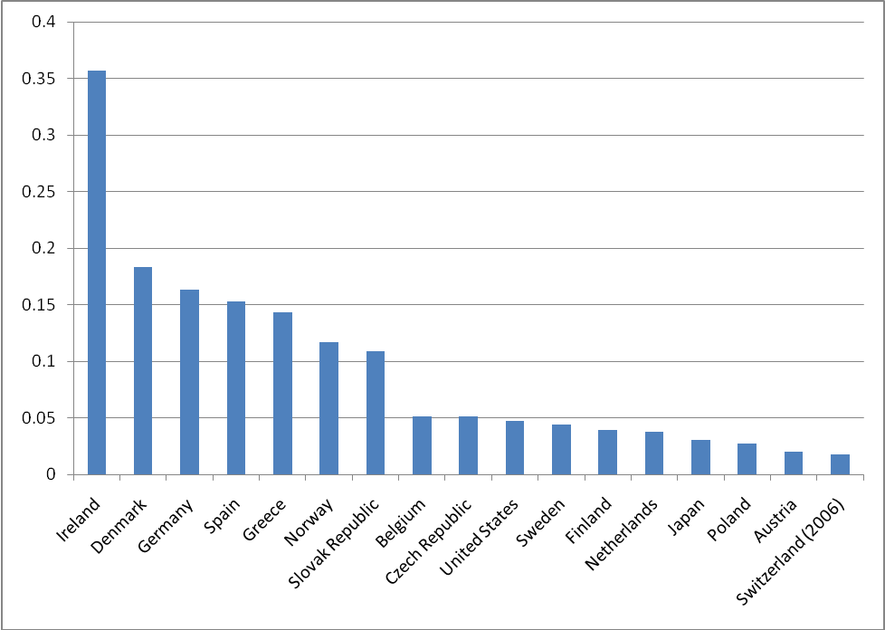
Government expenditure on ERD as a percentage of total (public and private, all levels) expenditure on education
Source : OECD, 2009. Data on ERD are for 2007. Data on expenditure on education are for 2006.
Notes:
The figure depicts very large differences among countries. On average the selected countries devote 0,072% of their national expenditure on education to ERD, but the variance is very large with values ranging from 0,35% in Ireland to 0,017 in Switzerland –that is, 20 times more.

Slide 5
Government expenditure on ERD as a percentage of the public expenditure on R&D
Source : OECD, 2009.
Notes:
If the ranking is limited to the public expenditure on ERD as a percentage of the public (only) expenditure on R&D, the values obviously increase but still the variance among countries is the most salient feature. If on average the value is 0,9% for 2008 (was 1,09% for 2007), countries go from 3,48% in Ireland to 0,18% in Austria –almost 20 times more. The following figure presents the values for 2007 and 2008 for the OECD countries for which these data are available.

Slide 6
General points
Low levels of investment in educational R&D
Weak research-policy links
Low system capacity
Methodology
Knowledge networks and brokerage
Scaling up and sustainability

Slide 7
Knowledge networks
Media
Leaders
Policy-makers Researchers
Practitioners
School boards
Parents
Capacity: strengths/weaknesses of each link?
Role of brokerage agencies?

Slide 8
Brokerage agencies
Issues/functions:
Dissemination: publications, internet, presentations
Promoting interactivity
Legitimating rigour/quality
Developing cooperation/trust
Questions
Which countries have educational brokerage agencies?
What are their achievements to date?

Slide 9
Use of knowledge base in policy making
Identification of needs
Evaluation & Monitoring
Development of policy
Knowledge base
What types of knowledge?
Tacit knowledge
Explicit knowledge
What knowledge sources?
Education research
Indicators, evaluations
Professional expertise
Anecdotal evidence, etc
Knowledge base
Outcomes
Output
Implementation

Slide 10
Governing Complex Education Systems
What models of governance are effective in complex education systems?
What knowledge systems are necessary to support this?

Slide 11
Governance model
Steering
Priority setting
Accountability
Policy Design
Implementation
Knowledge use
Knowledge production

Slide 12
GCES Outputs
Project Launch
Oslo
Second Thematic Conference
Warsaw
2011
2012
2013
First Thematic Conference
The Hague
Third Thematic Conference
..
Case Studies (ongoing)
Case Study Framework
Working Papers (ongoing)
Notes:
Today we will go over the key outputs that have been delivered thus far, as well as the planned outputs that we will still deliver in the rest of this biennium. You can see the full details in the project update that is the GB document for this meeting.
I will go over the thematic conferences, with special attention to the one that was held last week in Warsaw. Harald will brief you on the case studies. We will end with our proposal for work in 2013-14.

Slide 13
Thank you!
For more information:
www.oecd.org/edu/ceri/gces

Slide 14
Methodologies and epistemologies
Methodological debate:
Scientific ideal(s) vs best available
Warfare, mutual invisibility or complementarity
Capacity building:
What forms of capacity are most in need of strengthening?
How and by whom should this be done?

Slide 15
Effective Multilevel Governance London 25-26 March 2013
Coordination and alignment:
Is there an optimal division of labour among the different levels in the system that allows for maximum effectiveness while reducing overlap?
Trust and conflict:
How can sufficient levels of trust be ensured for the central and local levels to work together?
What is the role of a middle tier?
And what is the best way to manage conflicts between the different levels?

