Slide 1
SUPPLY, DEMAND AND EXPENDITURE ON LONG TERM CARE IN EU
Dr. Valentina Prevolnik Rupel
Institute for Economic Research, Slovenia

Slide 2
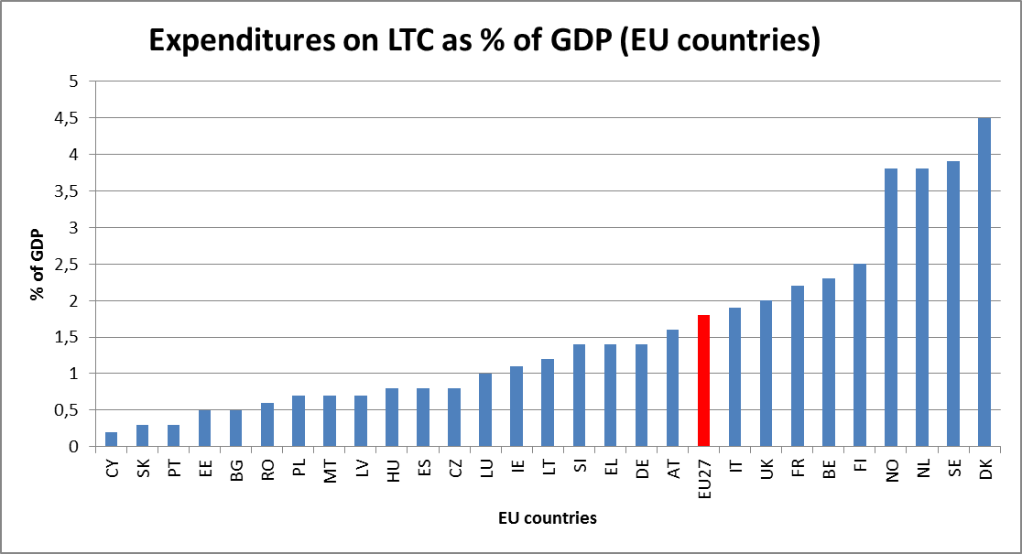

Slide 3
Determinants of supply of long term care services
Source: The 2012 Ageing Report, European Economy 2, 2012

Slide 4
Determinants of demand of long term care services
Source: The 2012 Ageing Report, European Economy 2, 2012
Demography = ageing of the population
ageing societies: progression of large birth cohorts, followed by smaller birth cohorts (fertility decline) and
2. ageing individuals: life extension of elderly at the high end of the life course
Disability: a person's perception of his/her ability to perform activities associated with daily living (ADL)
Dependency: different definitions across countries; inability to perform daily personal care tasks.

Slide 5
European project ANCIEN (Assessing Needs of Care in European Nations)
Goal: to prepare a typology of LTC systems in Europe
Typology 1 is based on system characteristics
Organisational depth: means-tested access, entitlement, availability of cash benefits, choice of providers, quality assurance, integration/coordination of care
Financial generosity: public expenditures as share of GDP
The higher financial generosity – the more patient friendly is LTC system
The deeper organization depth – the more patient friendly is LTC system
Typology 2 is based on use and financing
Public expenditure on LTC as a share of GDP
Private expenditure as a share of LTC spending
Informal care recipients aged 65+ as a share of population aged 65+
Support for informal care givers

Slide 6
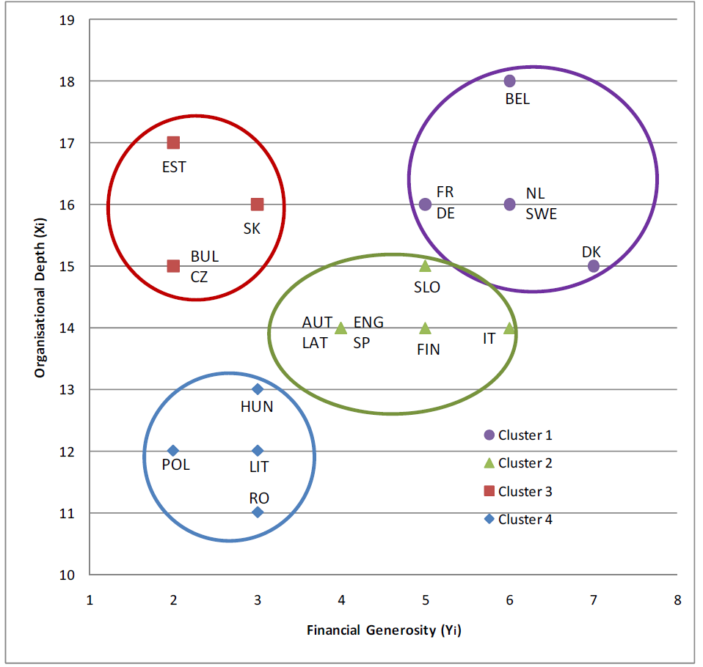
Typology of LTC systems based on system characteristics
Source: A typology of systems of LTC in Europe, results of WP1 of the ANCIEN project
www.ancien – longtermcare.eu

Slide 7
Typology of LTC systems based on use and financing
Nature of the system | Countries | Characteristics
Cluster A Informal care oriented, low private financing | Belgium, Czech Republic, Germany, Slovakia | Low public spending, low private spending, high IC use, high IC support, cash benefits modest
Cluster B Generous, accessible and formalised | Denmark, the Netherlands, Sweden | High public spending, low private spending, low IC use, high IC support, cash benefits high
Cluster C Informal care oriented, high private financing | Austria, England, Finland, France, Spain | Medium public spending, high private spending, high IC use, high IC support, cash beenfits high
Cluster D High private financing, informal care seems necessity | Hungary, Italy | Low public spending, high private spending, high IC use, low IC support, cash benefits medium
Source: A typology of systems of LTC in Europe, results of WP1 of the ANCIEN project
www.ancien – longtermcare.eu

Slide 8
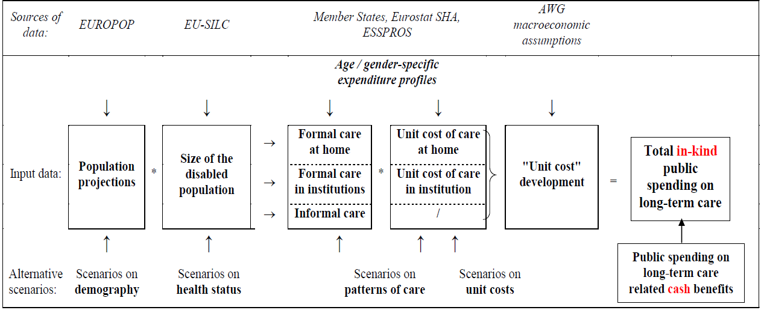
European Commission - Working Group on Ageing Populations (AWG) 9 scenarios of budgetary projections for 27 member states
Source: The 2012 Ageing Report, European Economy 2, 2012

Slide 9
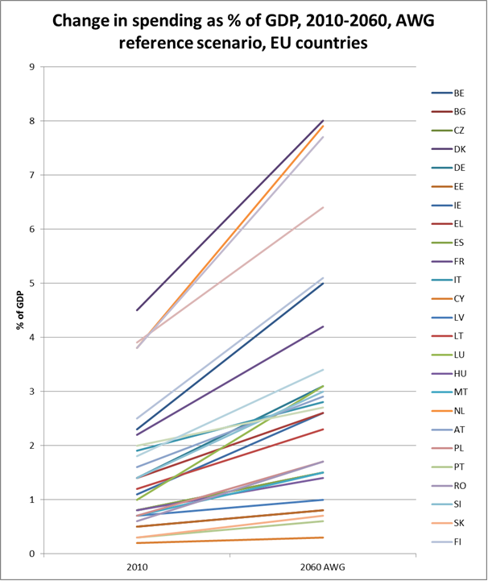

Slide 10
Future expenditure for LTC provision: the various scenarios
 | Constant disability | Demographic | AWG reference | Base case | Risk scenario | Cost convergence | Shift to formalo | Coverage convergence
BE | 2,4 | 2,6 | 2,7 | 3,0 | 3,5 | 3,9 | 3,5 | 3,0
BG | 0,3 | 0,4 | 0,3 | 0,4 | 0,4 | 0,5 | 0,5 | 0,9
CZ | 0,5 | 0,7 | 0,7 | 0,8 | 1,0 | 1,2 | 0,9 | 0,9
DK | 3,0 | 3,7 | 3,5 | 4,0 | 3,5 | 4,0 | 4,8 | 4,1
DE | 1,5 | 1,6 | 1,7 | 1,9 | 1,8 | 2,0 | 2,6 | 1,5
EE | 0,2 | 0,4 | 0,3 | 0,4 | 0,5 | 0,6 | 0,6 | 0,8
IE | 1,4 | 1,4 | 1,5 | 1,6 | 2,1 | 2,2 | 2,2 | 1,7
EL | 1,0 | 1,3 | 1,2 | 1,4 | 1,8 | 2,0 | 1,8 | 2,1
ES | 0,6 | 0,8 | 0,7 | 0,7 | 0,8 | 0,9 | 1,2 | 2,3
FR | 1,9 | 2,1 | 2,1 | 2,3 | 2,2 | 2,4 | 3,5 | 4,7
IT | 0,7 | 1,1 | 0,9 | 1,1 | 0,9 | 1,1 | 2,0 | 2,7
CY | 0,1 | 0,1 | 0,1 | 0,1 | 0,1 | 0,2 | 0,1 | 0,2
LV | 0,3 | 0,4 | 0,4 | 0,5 | 0,4 | 0,5 | 1,1 | 3,7
LT | 0,9 | 1,2 | 1,1 | 1,2 | 3,2 | 3,4 | 1,5 | 1,3
LU | 2,0 | 1,8 | 2,1 | 2,3 | 2,1 | 2,3 | 2,7 | 3,8
HU | 0,5 | 0,7 | 0,6 | 0,7 | 1,0 | 1,1 | 1,0 | 1,2
MT | 0,7 | 1,0 | 0,9 | 1,1 | 3,2 | 3,7 | 1,3 | 1,3
NL | 3,6 | 3,9 | 4,1 | 4,6 | 4,1 | 4,7 | 5,3 | 4,6
AT | 1,1 | 1,2 | 1,2 | 1,4 | 2,3 | 2,5 | 1,8 | 1,7
PL | 0,9 | 0,9 | 1,0 | 1,1 | 1,9 | 2,1 | 2,2 | 1,9
PT | 0,3 | 0,3 | 0,3 | 0,3 | 1,0 | 1,0 | 0,6 | 1,5
RO | 1,0 | 0,8 | 1,1 | 1,2 | 1,5 | 1,7 | 1,7 | 2,6
SI | 1,4 | 1,4 | 1,6 | 1,8 | 1,6 | 1,8 | 2,5 | 4,2
SK | 0,4 | 0,4 | 0,4 | 0,5 | 1,9 | 2,0 | 0,8 | 1,6
FI | 2,2 | 2,3 | 2,6 | 2,9 | 2,9 | 3,2 | 3,8 | 3,1
SE | 2,3 | 2,3 | 2,5 | 2,8 | 2,5 | 2,8 | 3,8 | 3,0
UK | 0,5 | 0,7 | 0,7 | 0,9 | 0,7 | 0,9 | 1,9 | 1,9
NO | 3,5 | 3,6 | 3,9 | 4,3 | 4,0 | 4,4 | 5,1 | 4,3
EU27 | 1,4 | 1,5 | 1,5 | 1,7 | 1,7 | 1,9 | 2,6 | 3,2

Slide 11
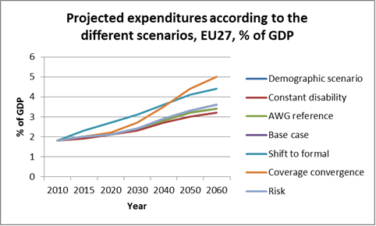

Slide 12
Thank you!
rupelv@ier.si

