Slide 1
European Institute for Gender Equality Making Equality Between Women and Men a Reality for All Europeans and Beyond

Slide 2
Management Board (Member States) Experts’ Forum Working Groups Thematic Networks Civil Society Social Partners Academia

Slide 3
Our vision
Making equality between women and men a reality for all Europeans and beyond

Slide 4
- Becoming the European competence centre on gender equality issues; - Supporting better informed policy-making at EU and Member States levels; - Creating increased awareness among decision makers and the public of progress and challenges in implementing European gender equality policies.
We will achieve it by:

Slide 5
Providing comparable and reliable data and indicators on Gender Equality
Collecting and processing methods, tools and good practices for gender equality work

Slide 6
Collect
Process
Produce
Disseminate
Sex dis-aggregated data
Gender Equality Index
BPfA review in EU
Beijing Reports for EU Presidency countries
Gender-based violence
Gender mainstream-ing
Methods and Tools
Competence Development
Good Practices
Data
IPA
Gender Statistics Database

Slide 7
Gender Mainstreaming
Gender equality competence development
Dissemination of good practices
Institutional capacity for gender mainstreaming
Sectoral approach

Slide 8
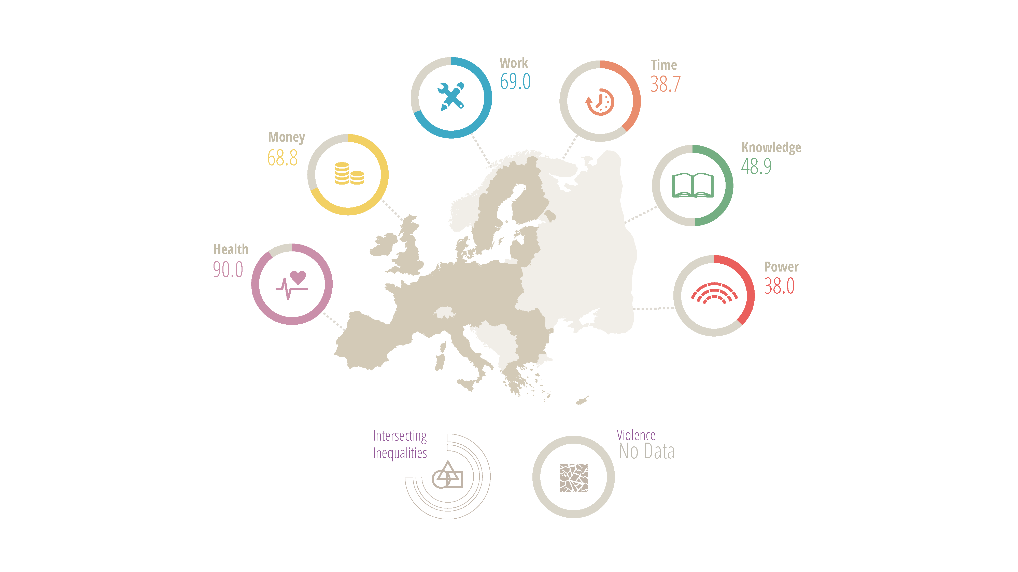
EIGE’s Gender Equality Index
69.0
38.8
68.9
48.9
90.1
38.0
Notes:
These are domains of the Gender Equality Index with the score for EU27.
Flexibility of the index
Low scores
No data
EU is only halfway towards gender equality
Equal share of caring activities crucial to reach the EU’s employment target
Combating violence against women seriously hampered by data gaps
Low levels of gender equality in decision-making

Slide 9
Managing Gender Knowledge
EIGE
Resource & Documentation Centre (RDC)
Documentation Centre / Specialised Library
Knowledge Centre
EuroGender Network
Process / Produce
Collect
Share

Slide 10
Our work on gender based violence
Beijing +20 Review
Female genital mutilation
Gender statistics, research, methods, tools and good practices, awareness raising
Sexual violence
Costs of violence
Administrative data sources
Domestic violence
Support services for women-victims of domestic violence

Slide 11
Support for the Presidiencies of the Council of the EU
6 reports
6 main findings
6 reports, 6 Main Findings for Polish, Danish, Cypriot, Irish, Lithuanian, Greek and Italian Presidencies.

Slide 12
Campaign viewed ~60.000 times on „Facebook“
White Ribbon Campaign
60.000
21
9
more
21 posters were published
9 videos were released (promotional statements and interviews)
Online discussion held
New members joining
Follow-up: newsletter on campaign notes and updates

Slide 13
- Cooperation Agreement / Memorandum of Understanding; - Regular consultation meetings; - Visits to the Institute; - Awareness Raising Campaigns; - Strategic Plan – Key Stakeholders International Activities.
Stakeholder Management

Slide 14
EuroGender: 1 year anniversary
EuroGender bridges decision-makers, researchers and experts from all EU MS and beyond while exchanging views, knowledge and resources on gender equality.
22.000
26
12
10.795
More than 22.400 visits
26 online discussions held
12 thematic network workspaces, calendar of events and conferences
10.795 gender equality stakeholders

Slide 15
Instrument for Pre-Accession Assistance (IPA)
Establish contacts, assess the needs and expectations of the enlargement countries
Strengthen the capacity of enlargement countries to comply with the EU policies in the field of gender equality
Explore ways/forms of further cooperation with EIGE in the area of gender equality

Slide 16
EIGE’s Database on Gender Statistics
A collection of statistical data and associated metadata pertaining specifically to the area of gender statistics
Publicly available
Logically grouping indicators/structured guide for selecting statistics
Tree-based browsing interface and keyword search
Updating all data whenever updates become available
Data and metadata
Present the Index-relevant statistics along with other types of gender statistics

Slide 17
Support better informed decision-making 2013-2015
Developing reliable and comparable data:
- Gender Equality Index
- Database on Beijing Indicators
Providing reliable information and data on gender-based violence and identifying existing gaps
Providing access to a processed and validated database of tools, methods and good practices for gender mainstreaming
Developing an analytical tool that identifies the benefits of gender equality

Slide 18
Contribute to awareness-raising 2013-2015
Establish an institutional memory and become the European knowledge centre on gender equality issues, through EIGE’s RDC
Facilitate the exchange of knowledge and efficient use of existing resources through online debates and other events
Implement communication strategy

Slide 19
- Gedimino pr. 16, LT-01103 Vilnius, Lithuania - eige.europa.eu - twitter.com/eurogender - facebook.com/eige.europa.eu - youtube.com/user/eurogender - eige.europa.eu/newsletter
Let‘s talk:

