Slide 1
Barriers to work for men and women in Serbia: Findings from Qualitative Analysis
María E. Dávalos
November 16th 2015

Slide 2
Findings of two studies
Economic Mobility, Labor and Gender
(country report, ongoing regional report)
9 countries, in Serbia:
4 communities (1 rural and 3 urban)
FGs with employed and jobless people, and youth
Interviews with key informants
Life stories
Child and Elder Care in Serbia
(country and regional report)
7 Countries, in Serbia:
9 focus groups, 18 childcare facilities, 8 elder care facilities, 5 intermediaries
Desk review of the literature
Supply assessment using mixed methods
Demand assessment: households with children and/or elders, including quantitative individual-level questionnaires and FGs

Slide 3
Overview
Jobs and economic mobility
Barriers to jobs, a focus on:
Attitudes, social norms, discrimination
Child and Elder Care
Policies
1
2
3

Slide 4
1. Jobs and economic mobility

Slide 5
The ladder of life

Slide 6
Jobs are the main factor determining position in the ladder, across countries and in Serbia
Several people employed (with higher income) or extra sources of income
Women: e.g. administration, education, healthcare; bank; “Mini”/“midi” entrepreneurs
Men: e.g. craftsmen, caterers, “Mini” and “midi” entrepreneurs
Several people employed, low wages
Women: informal self-employed/low-skilled and low-paying jobs
Men: blue collar jobs (driver, couriers), farmers, others (like mechanic, electrician, locksmith, etc.)
One person employed
Women: don’t work for pay or casual work
Men: low-skill work at minimum wage (e.g. construction, picking fruit)
Step 3
Step 2
Step 1: Poorest households

Slide 7
Jobs are the main factor determining position in the ladder, across countries and in Serbia
One person working, usually the man
Women: usually don’t work. If they do: singers, celebrities, owners of catering or trade companies, educated experts
Men: politicians, entrepreneurs, directors and managers, educated experts
Several sources of income (one to two good salaries) plus different sources of income
Men and women have similar jobs, educated people employed on high positions: Medium and top managers, Working at the university, “Maxi” entrepreneur
Step 5: Richer households
Step 4
Source: 8 focus group discussions with working men and women.

Slide 8
Jobs are considered to be the main factor for getting ahead in life
Factors that promote upward mobility according to adult men and women
Source: 16 FGDs with working and non-working adults

Slide 9
… but they are also the main factor behind falling back and into poverty
Factors that promote downward mobility according to adult men and women
Source: 8 FGDs with working and non-working adults

Slide 10
What can improve men’s and women’s access to jobs?
Source: 16 FGDs with working and non-working adults.

Slide 11
Jobs for women: Women, in particular, face a multiplicity of barriers to work across countries
Access to services: childcare
Geographic
mobility
Attitudes, social norms, discrimination
Labor regulations and work arrangements
Access to productive inputs, information and networks
Skills

Slide 12
2. Attitudes, social norms, discrimination
- a barrier not captured by quantitative surveys -

Slide 13
This barrier can shape women’s, families’ and employers’ decisions, and goes from social norms….
“A woman is not expected to contribute economically; her value is recognized in the private sphere only: she is to be a good wife, housewife, to have a clean home and well brought up children” (unemployed man)
“Our country is still ruled by patriarchal norms. I do a typically female job, but the manager is always a man…’’ (employed women)
“Women here don’t chase a career at the expense of their children” (employed woman)

Slide 14
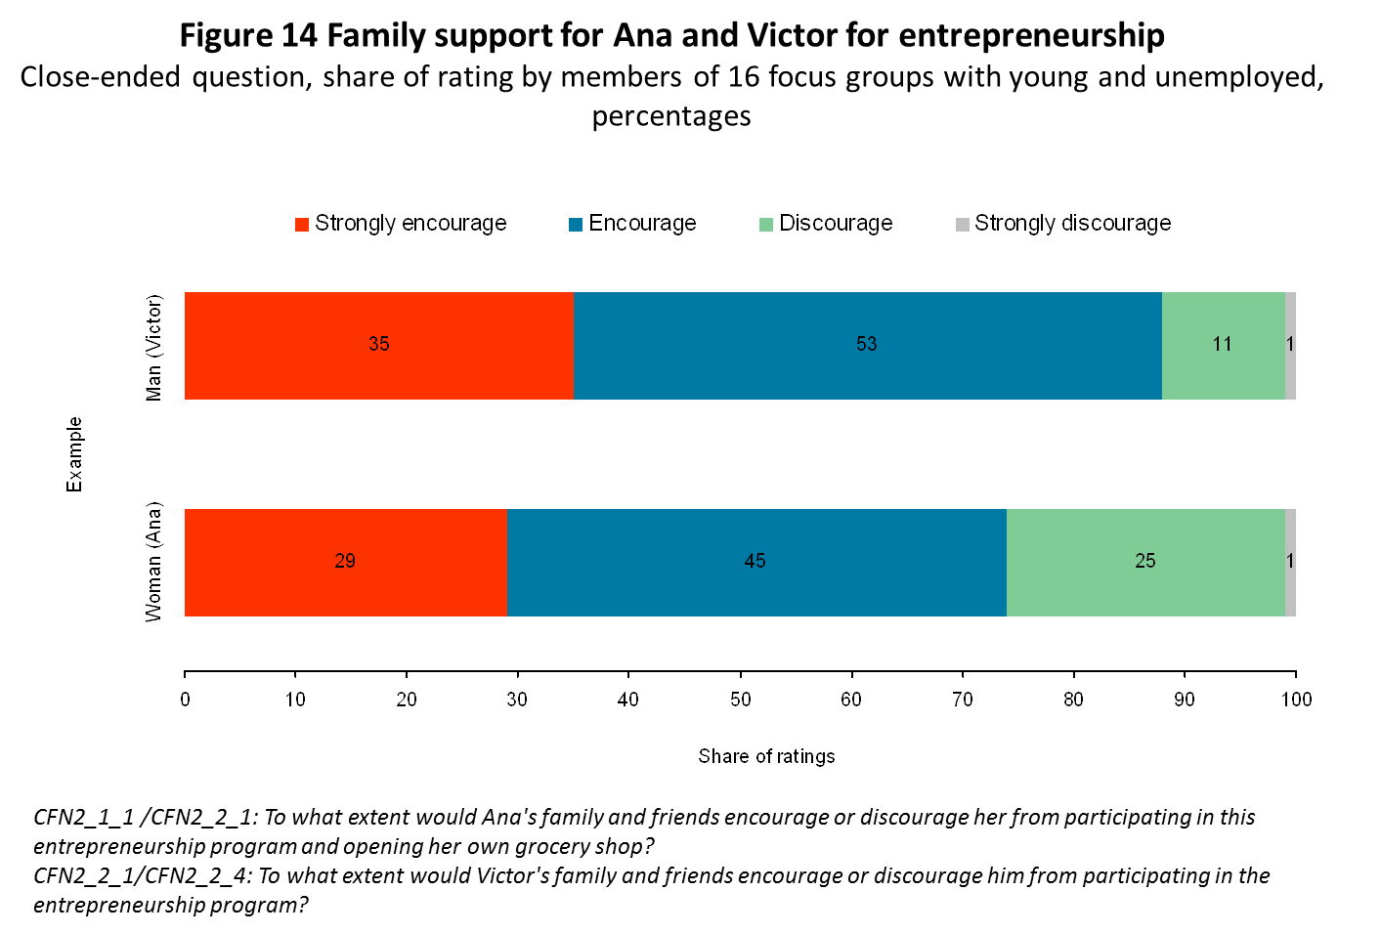
… with can shape women’s choices….
To what extent the family and friends of a woman (Ana) or a man (Victor) encourage her or him to participate in an entrepreneurship program and own a grocery shop?
Source: 24 FGDs with working and non-working adults and youth.

Slide 15
… to discrimination by employers
“I think hard before I hire a young married woman without children.” (woman employer)
“It is risky to employ a young woman because a woman has to take care of her children, and if these children get sick, she won’t be able to come to work.” (employed woman)
“My latest CV, as recommended by the director, contains the following: I am a single parent with two underage children, I am not planning to get married any more, I AM NOT PLANNING TO HAVE ANY MORE CHILDREN – I had to write this in capital letters, underlined, I am of very good and unspoiled health, my children have someone to take care of them when they get sick.” (unemployed woman)
“I’ve had tons of job interviews when employers openly asked me whether I was planning to have children in the future, and when I said yes, each one of them thanked me and showed me the door. It used to be a taboo, but it’s not anymore.” (unemployed woman)

Slide 16
4. Child and elder care

Slide 17
Access to care services can impact women’s access to economic opportunities
Evidence is robust on
How female labor force participation is affected by the availability and affordability of childcare and subsidized child care services have positive (but heterogeneous) effects on labor supply.
How intensive, time-demanding care (such as that requiring more than 20 hours per week) has significant negative effect on the likelihood of staying in the labor force
In Serbia,
Having small children (up to the age of 2), however, increases the activity of men, while it decreases the probability of women being active (SIPRU/World Bank, 2015).
Signs of rising demand for care services in Serbia indicate an opportunity to develop a formal care industry that can provide jobs, in particular for women with low skills.

Slide 18
Childcare: key constraints in Serbia
Limited availability of affordable services characterizes existing formal childcare services
Demand of formal childcare services is voiced predominantly by parents perceiving benefits for child’s development and working (or willing to work) mothers.
Quality is important for potential users and the main challenges of the existing supply involve child-staff ratios and infrastructure
→ According to the latest SORS data, in 2015 the shortage of capacities amounts to almost 15,000 missing slots. Out of those, 4,000 children have not been accepted due to lack of capacities and 11,000 children have been accepted over the capacity (SIPRU/World Bank 2015).

Slide 19
Perceptions on childcare in Serbia
Availability is limited, especially in rural areas, and existing childcare facilities are at over capacity
Hours of operation of childcare do not always meet care needs of communities
Overcrowding and high child-staff ratios in public centers are mentioned as main concerns
“I couldn’t work. There was no kindergarten (…) And even if you have money, there is no one to look after your child. You can’t hire a woman here to look after your child, since every woman has to work in the field and at home, all day long.” (Rural woman, Serbia).
“A few hours don’t mean anything to people, but all day stay really is very relevant because of agriculture.” (Rural man, Serbia)
“There are simply too many children so they can’t work with them individually [in public centers]” (Urban woman, Serbia).
Source: ECA Care FDGs Qualitative dataset. Independent mixed-methods research study (2014)

Slide 20
Eldercare: key constraints in Serbia
Social norms are a strong deterrent for use of residential eldercare while use of day-care centers and home-based formats –if available- would be more compatible with prevailing standards.
Supply of eldercare is characterized by lack of day-based services and limited and expensive availability of residential care centers.
Quality is important for potential users and the main challenges of the existing supply involve infrastructure and safety features.

Slide 21
Perceptions on eldercare
FGDs suggest a mismatch between available care formats and norms of care
Caring for elderly by family members at home is viewed predominantly as an obligation as well as the most appropriate way of helping
Day-care centers and home-based formal eldercare formats are more compatible with social norms: regular visits by social workers or NGOs are voiced as important benefits for the elderly.
Discussions suggest a gradual shift in norms in Serbia with regards to using formal eldercare
“We all have responsibility towards the parents who created and reared us. Not everything can be paid in cash. I need to pay them back in responsible and kind behavior” (Urban man, Serbia).
“An elderly care home costs around 400 Euros. I was able to pay this, but I would never do this to my father” (Urban woman, Serbia).
“Some caregiver or other paid woman to be paid to come to her house, that’s fine, but she won’t leave her doorstep.” (Rural woman, Serbia)
“Of course, we are a generation that will consent to our children sending us to these homes for eldercare, but our parents are still traditional and that this is a foreign [alien] concept for them” (Urban woman, Serbia)
Source: ECA Care FDGs Qualitative dataset. Independent mixed-methods research study (2014)

Slide 22
5. Policies

Slide 23
Policies to influence social norms and discrimination
Social norms, in particular, can be influenced by:
1. Promoting greater knowledge about alternatives (lower cost of learning about options)
2. Promoting the coordination of individuals to challenge social norms or collective action

Slide 24
Examples: policies to influence social norms and discrimination
Shifting aspirations with exposure to role models such as political leaders and successful small business owners (e.g. Indian female political leaders)
Shifting norms with increased job opportunities for young women (e.g. Delhi call centers)
Exposure to information and role models through the media to influence mental models of individual viewers (e.g. soap operas, radio); very effective in Brazil and the US.
“Mindset” interventions to fight stereotypes of what men and women can achieve
Reveal to employers their own biases: create checklists for them to make sure they are not weighing beliefs over facts;
Increased female participation in decision-making or shaping the context in which decisions are made
Enforcement of laws on discrimination by gender
Firms gender certification – HR processes
.

Slide 25
Policies to increase access to childcare so women can work
National Strategy for Improving the Position of Women and Promoting Gender Equality for 2010-2015 includes policies that allows reconciliation between family and work life (e.g. child and elder care)
A rising demand for care services in Serbia provides an opportunity to develop a formal care industry; policy options include:
The expansion of publicly provided childcare centers
Creation of education and accreditation programs to prepare caregivers and care-entrepreneurs
Development of a plan to increase quality of care services with attention to costs
Design of an elder care system considering the impacts on care recipients but also on informal care providers (mostly women) and their ability to contribute to sustained economic growth

Slide 26
Thank you.

